Slide 1

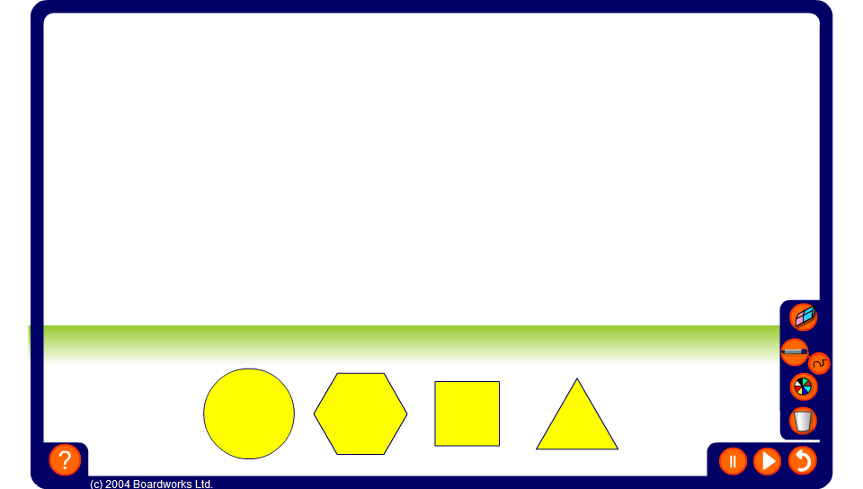

Rolling shapes along lines
Notes:
Use this activity to demonstrate the locus of points traced out when various shapes are rolled along a straight line.
Ask pupils to describe what they expect the locus to look like before revealing it.
Draw attention to the fact that the more sides the shape has the more the path traced looks like that of a circle.

